Slide 1
Parent pointer trees
Grigor Patricia-Carla / Valentina Hofecker

Slide 2
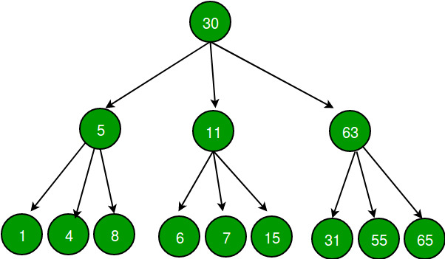
overview
belongs to the N-ary tree data structure
allows up to n children nodes
nodes store the address of children nodes
first node = “root“
nodes of the last row = „leaves“
number of children for each node is unknown in advance

Slide 3
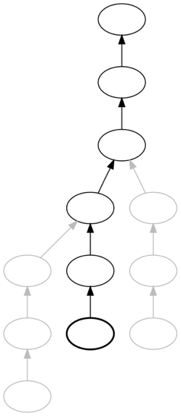
Parent Pointer Trees / Spaghetti Stacks
special form of generic trees → child nodes point to parent nodes
root does not contain a pointer → defined as root
Tree traversal: bottom – up (leaf to root)
„spaghetti stack“ → when used to implement sets of stacks
→ Space complexity: O(n)

Slide 4

spaghetti stacks cactus stacks sahuaro stacks

Slide 5
Use cases
Use in compilers
compilers use spaghetti stacks when opening/closing symbol tables representing block scopes
block scope opens → symbol table pushed onto a stack
when curly brace is encountered → scope is closed; symbol table is popped
BUT: symbol table is remembered rather than being destroyed!

Slide 6
2. Use as call stacks
used to implement the actual run-time stack in programming languages that support continuations
= languages that allow abstract representations of the flow of a program
spaghetti stacks allow saving specific points in a program which can be returned to at a later point ( local variables are not forgotten)
allow stack frames to be dynamically allocated so that memory is not forgotten

Slide 7
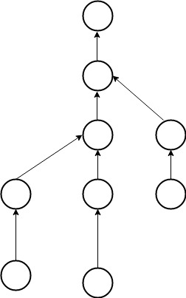
2. Used to implement disjoint-set data structures
disjoint-set data structure / union-find data structure /
merge-find set
= data structure that stores a collection of disjoint
/ non-overlapping sets
provides operations for:
adding new sets
merging sets
finding out if two elements belong to the same set or not

